Slide 1




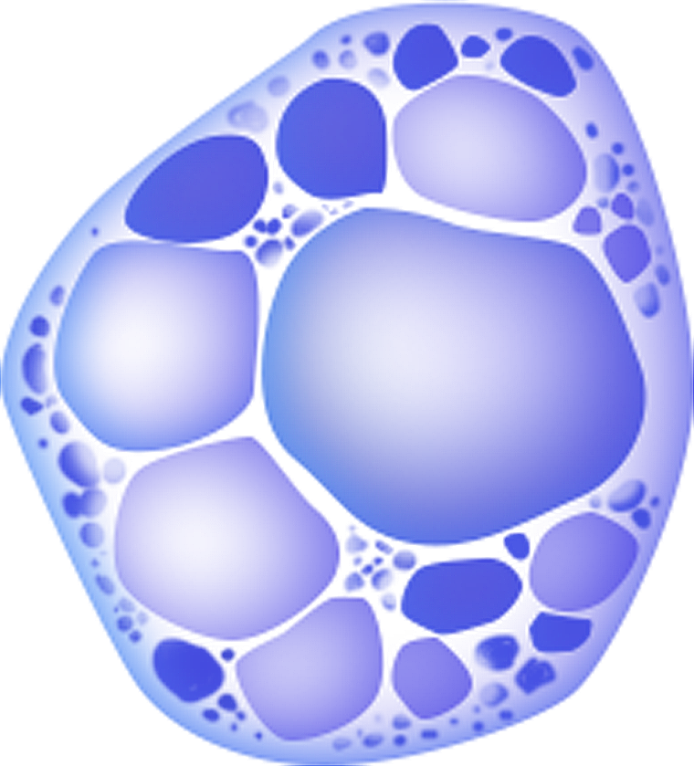
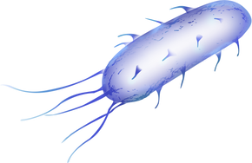

ICT2403– Graphics and Image Processing
FUNGI COLONY
ANALYSIS
By Team Rhizopus
RAJARATA UNIVERSITY OF SRI LANKA
Department of Computing

Slide 2

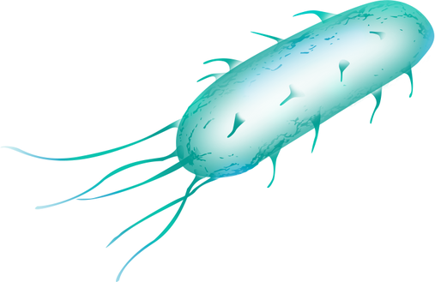
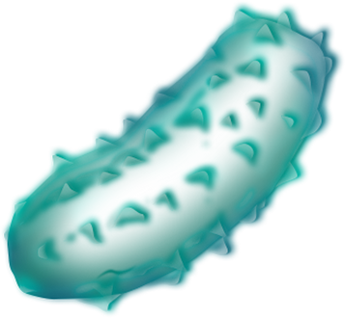

Contents
01.
Image Acquisition
02.
Pre-processing
03.
Segmentation
04.
Result Analysis and Evaluation

Slide 3
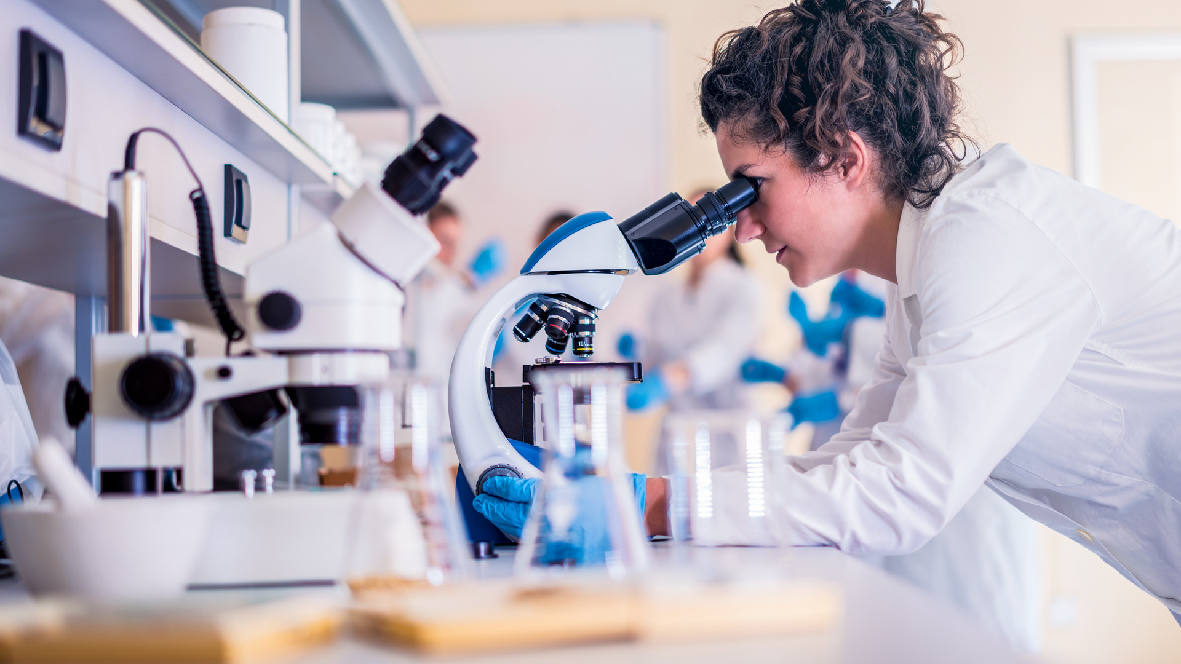
Introduction
Importance of fungi colony analysis
Food Safety
Pharmaceuticals
Biological Research
Objectives of the image pre-processing model

Slide 4

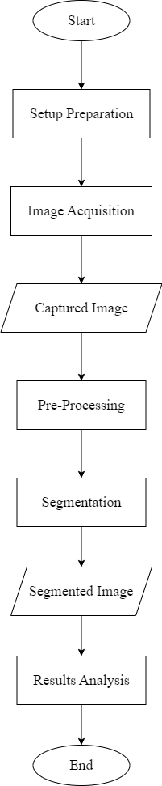


Slide 5
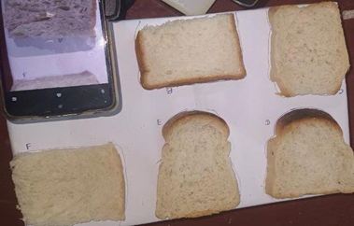
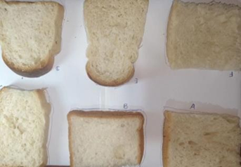
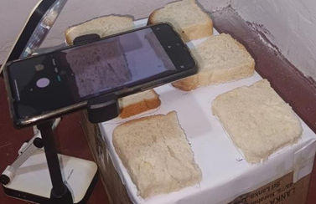
Substrate:
Bread slices from 6 different brands (P & S Bakehouse, Chamee Restaurant & Bakery, Ruhunu Hotel, Dutta Canteen, Mihintale Hotel, Anuradapura hotel)
Experimental Setup
Environment:
A controlled setup using a cardboard box with the top covered by a white sheet to minimize external environmental influences.
Equipment:
Mobile cameras, tripod, and table light.

Slide 6
Procedures:
Slices were cut to the same size and stored in a suitable environment for 14 days.
Photographs were captured 2 times daily to document changes in fungal growth.
Image Acquisition Parameters:
Daily captures at the same time each day to minimize environmental variations.
Standardized camera settings for resolution, focus, and lighting to ensure consistency in image quality.

Slide 7


DATA COLLECTION PROCESS
Kept the dataset for 14 days
Notable fungal growth from day 5 to 14

Slide 8
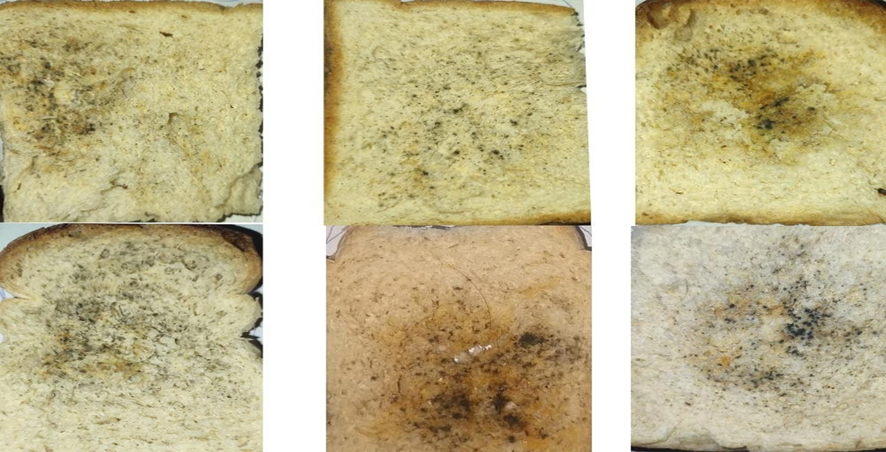
Dataset Description

Slide 9
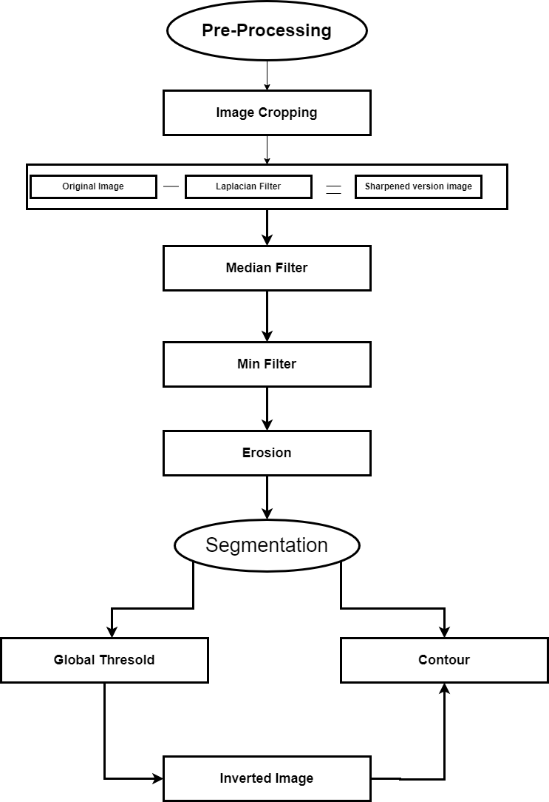

Slide 10

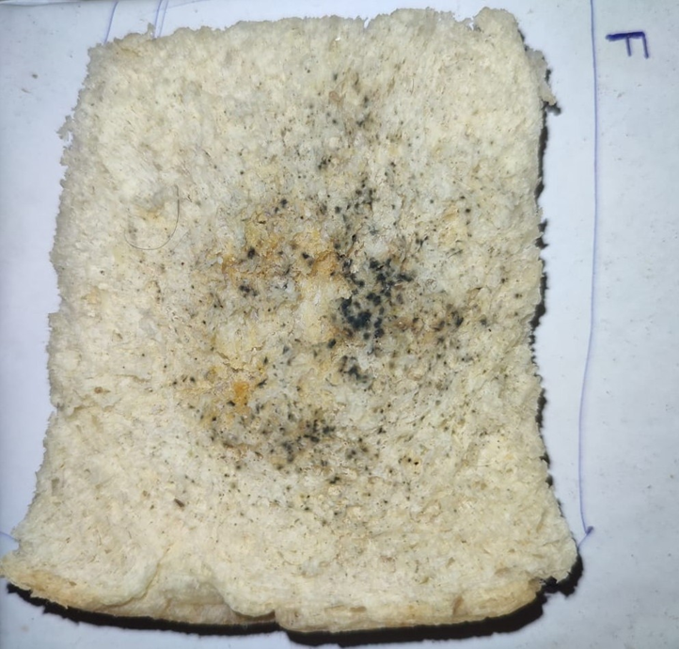
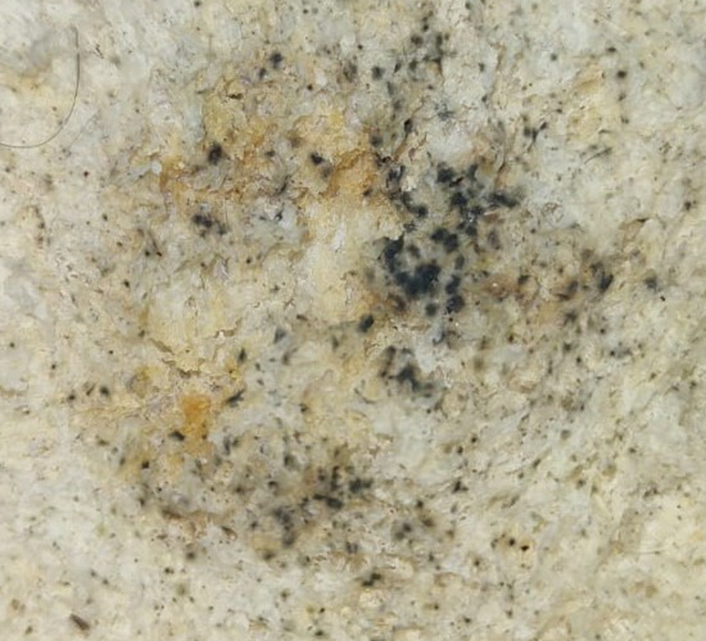

IMAGE PRE-PROCESSING TECHNIQUES
•CROP IMAGE
Original Image
Cropped image

Slide 11

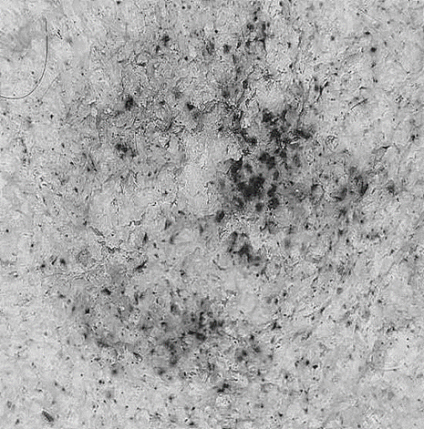
•SHARPENING
Cropped image
Laplasian filtered image
Sharped image

Slide 12

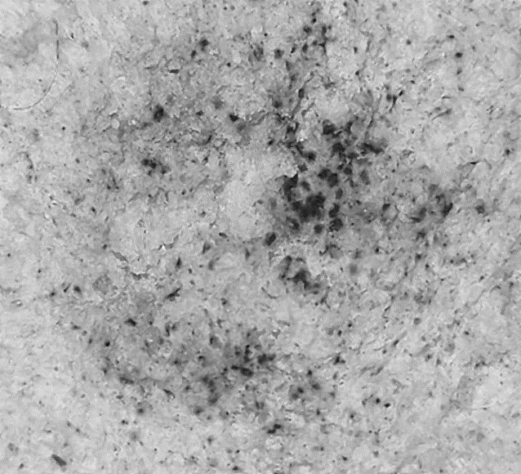

•SMOOTHING
Non-linear filters
Median Filter
Sharped image
Median filtered image

Slide 13
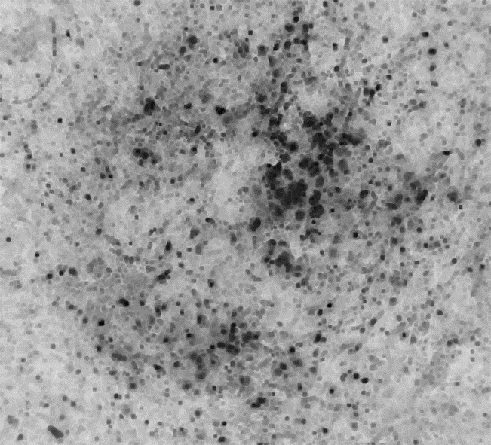
Max and Min Filter
Median filtered image
Min Filtered Image

Slide 14

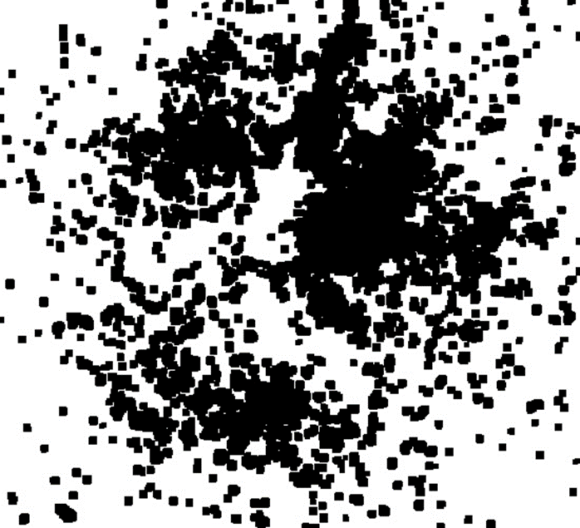
SEGMENTATION
•EROSION
Min Filtered Image
Eroted image

Slide 15
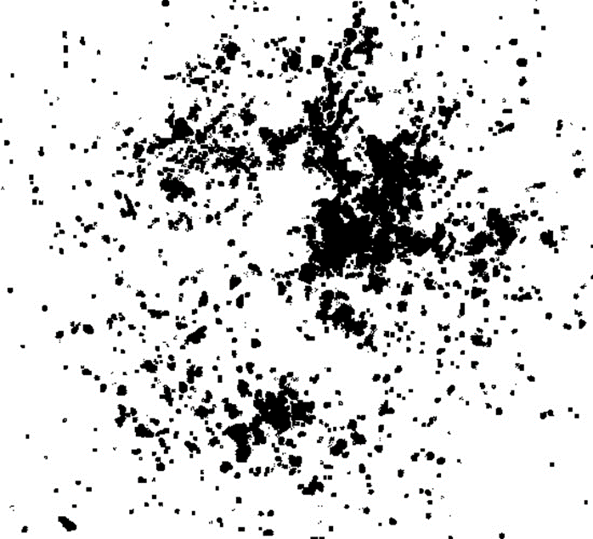
•GLOBAL THRESHOLDING
Eroted image
Thresholded image

Slide 16
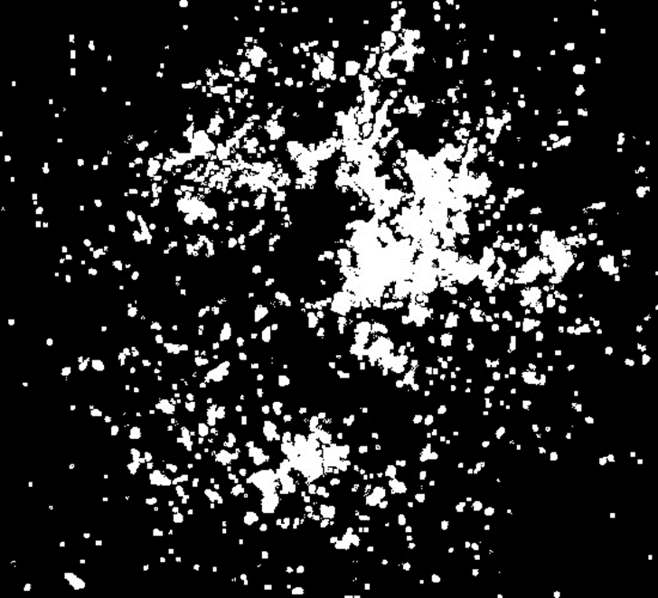
•INVERTED TO BINARY IMAGE
Thresholded image
Binary image

Slide 17
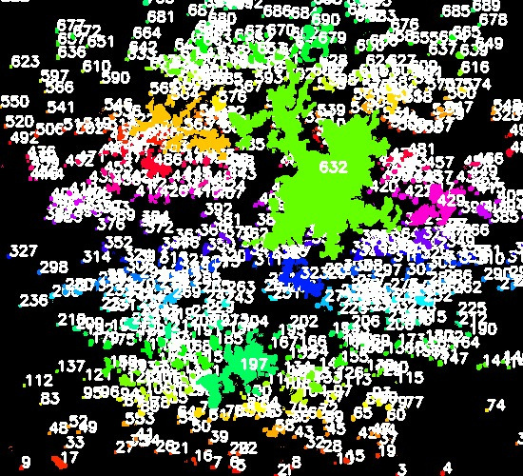
•CONTOUR DETECTION
Binary image
Contour Detection

Slide 18
ANALYSIS

Slide 19
Discussion
Image Cropping
Focuses the analysis on the relevant region containing the bread slice and fungal growth and
removes irrelevant parts of the image.
Laplacian Filter:
Enhanced edges, making the boundaries of fungal colonies more prominent.
Sharpening
Increased contrast and visibility of fine details in the fungal colonies.
Median Filter:
Reduced noise, with preserved edges, resulting in a cleaner image.
Min Filter:
Further noise reduction and better separation of closely spaced colonies.
Erosion:
Smaller, separated fungal colonies with reduced noise and clearer boundaries.

Slide 20
Challenges Overcomes
Maintaining proper light exposure
Used a light stand to avoid shadows while
capture images.
Ensuring the same positioning of bread slices in photographs.
Maintained a proper photography setup.
Used a tripod to ensure consistent position.
Handling and organizing of images captured over the experiment period.
Compared the captured images and chose the proper image for our coming implements.
Dealing with noise in images that can obscure or distort fungal features.
Apply image preprocessing techniques such as noise reduction filters.
Determining the optimal frequency and timing for image capture to accurately document growth.
Establish a consistent schedule for image capture, such as two times daily.

Slide 21
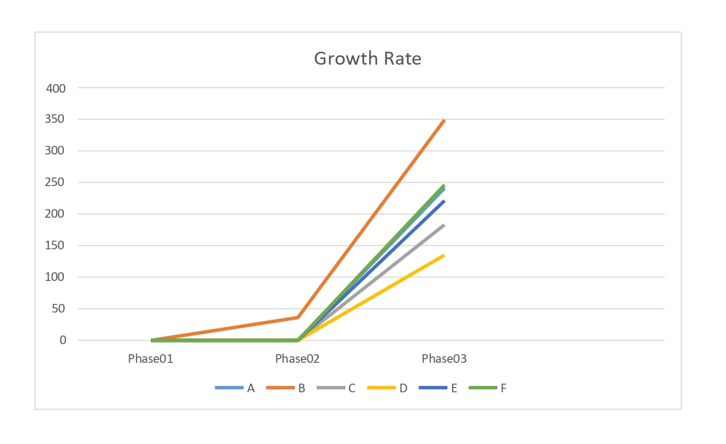
Objective 01
Objective 02
Objective 03
Objective 04

Slide 22
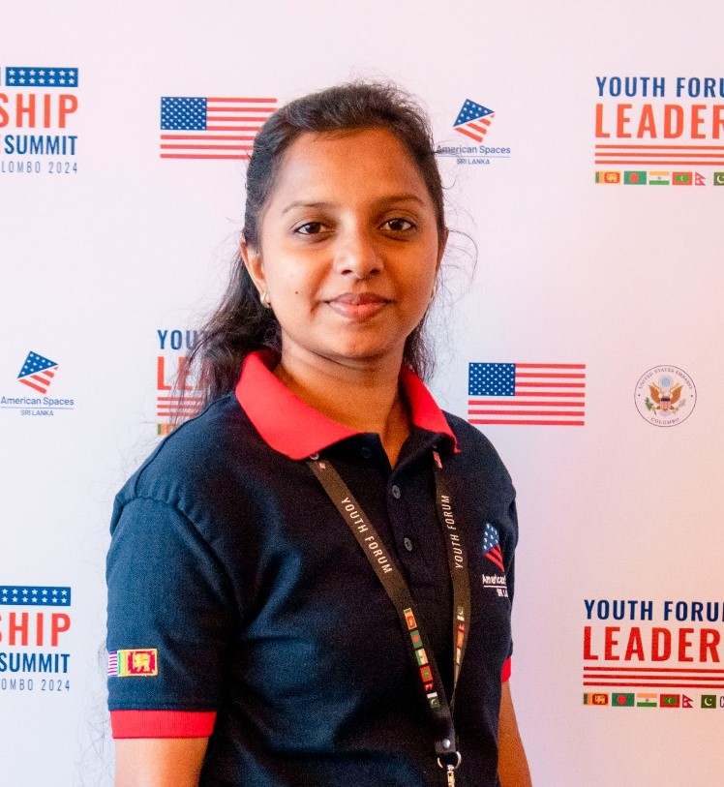

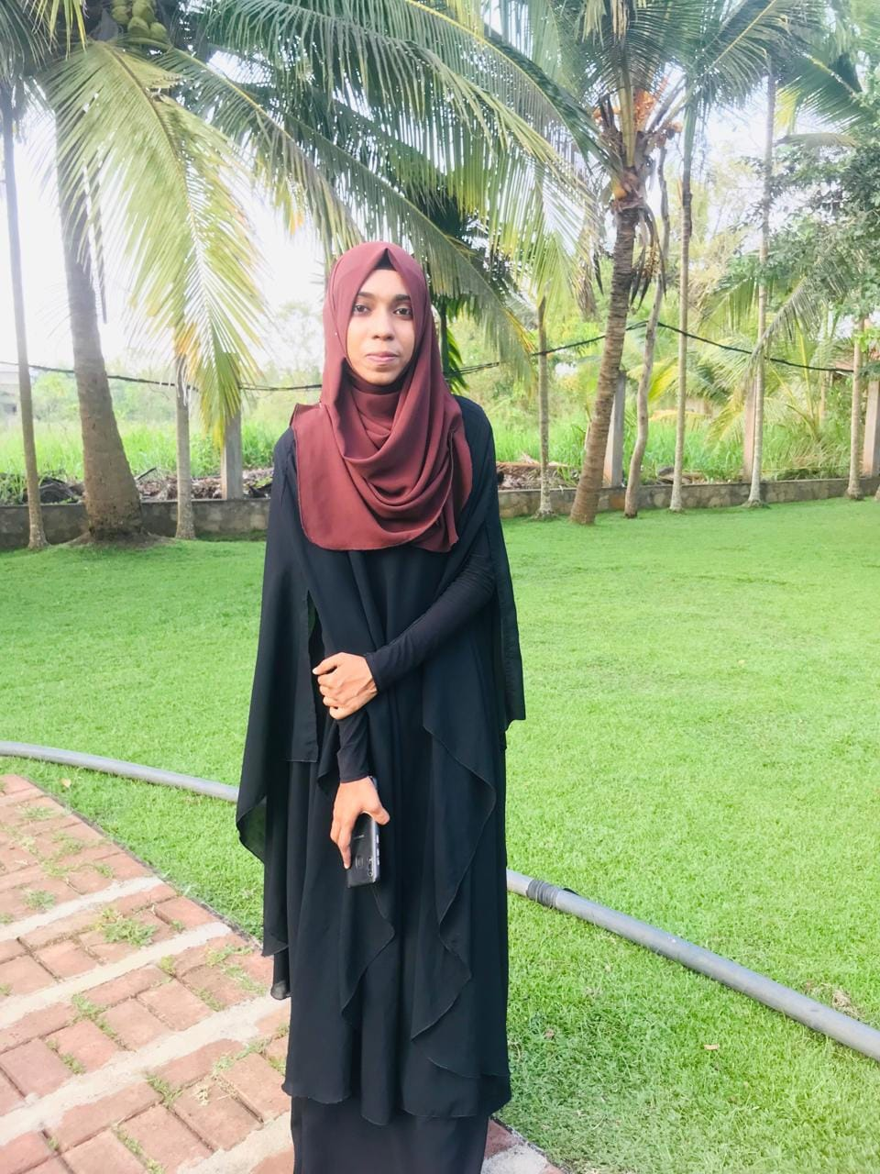
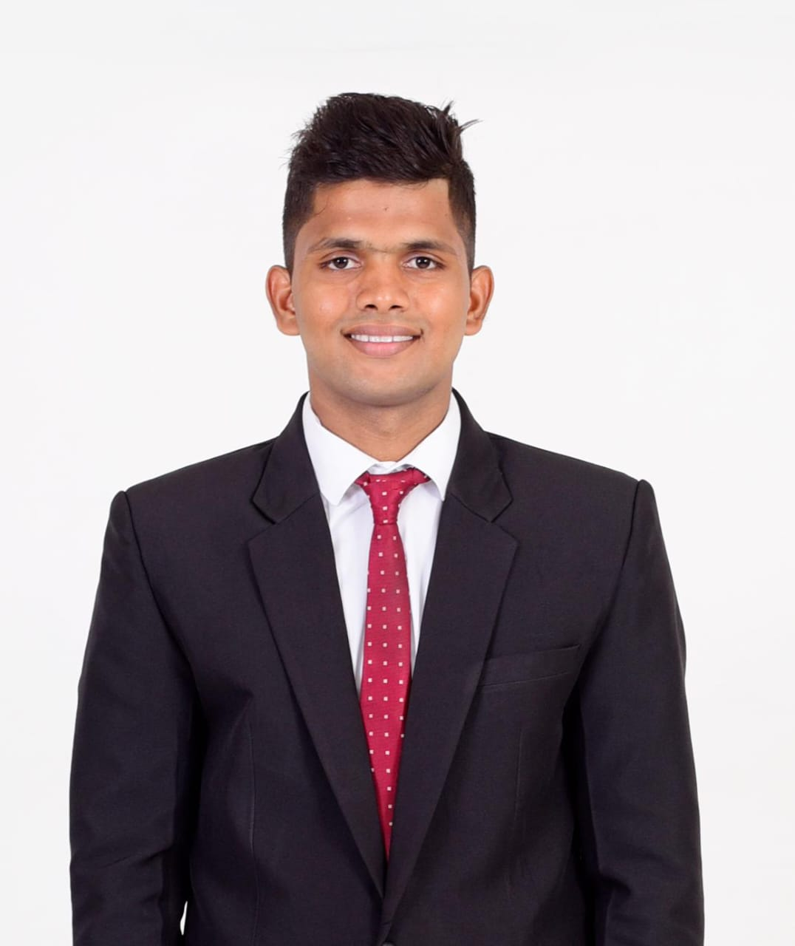
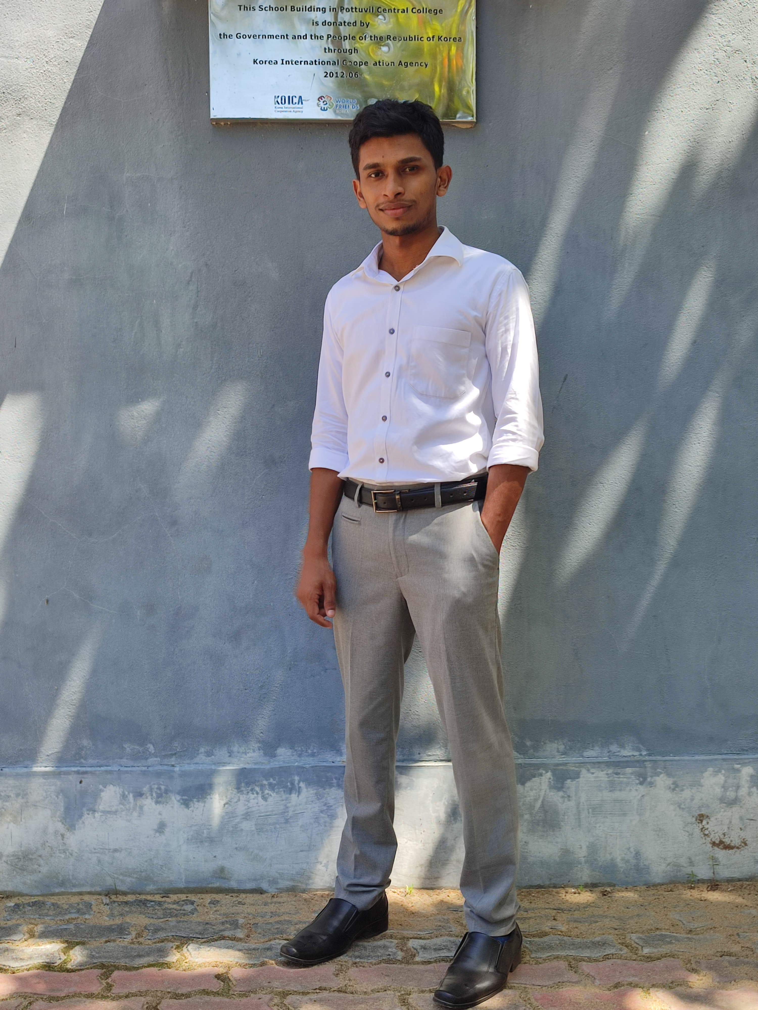

TEAM RHIZOPUS
Inthuja.S
Sivalojan.S
M.S.F Nazeeha
M.N.M Haflullah
M.R.M Shimer
M.N.M Asmath

Slide 23
THANK YOU

